Slide 1
NXT-G Binary Bluetooth Functions
An Introduction to Brick-to-Brick Communication

Slide 2
Overview
History of Bluetooth
How Bluetooth Works
Activating Bluetooth on the NXT Brick
Disconnecting Bluetooth on the NXT Brick
Programming Binary Bluetooth Commands
Programming the Transmitter
Programming the Receiver
Parting Thoughts

Slide 3
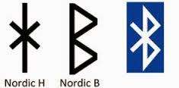
History of Bluetooth
Bluetooth was invented in 1994 by Ericsson, a Swedish telecommunications technology company.
Named after Harald "Bluetooth" Gormsson, an historical king of Denmark and Norway who united the peoples of those countries.
The name was suggested in 1997 because it united several communication standards and it wasn’t yet used for a trademark
The symbol for Bluetooth comes from combining the two runes that make up the initials of Harald Bluetooth

Slide 4
How Bluetooth Works
Bluetooth uses radio frequencies dedicated for Industrial, Scientific, or Medical (ISM) purposes.
Operating at frequencies between 2.4 to 2.485 GHz
Has a master-slave piconet architecture where one device is the master that can interact with up to 7 slave devices. In the NXT system there are a maximum of 3 slave devices

Slide 5
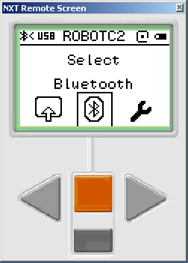
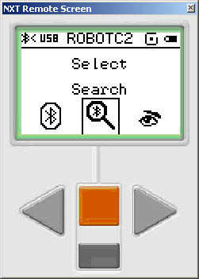
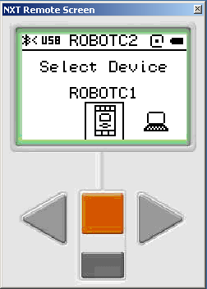
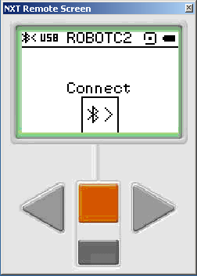
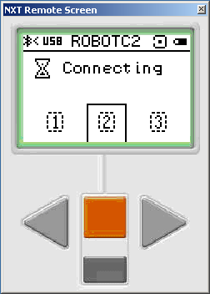
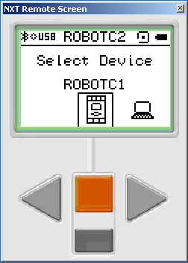
Activating Bluetooth on the NXT Brick
1
2
3
1) Scroll over to Bluetooth, press orange button
2) Scroll over to search, press orange button
3) Once search is done, select device you want to link to press orange button twice to connect
4) Select which device number the brick will be
5) Once done, there will be a diamond in the upper left corner next to the Bluetooth symbol
3
4
5

Slide 6
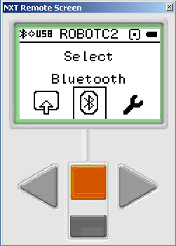
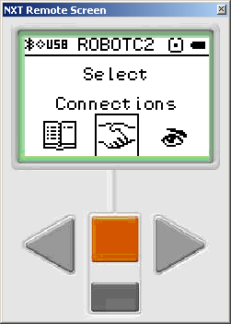
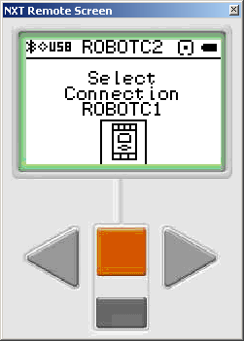
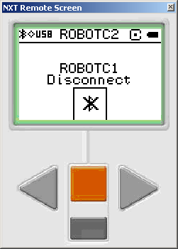
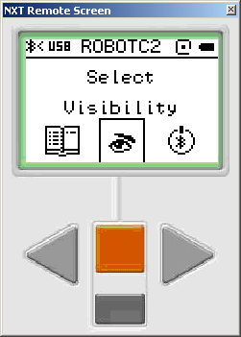
Disconnecting Bluetooth on the NXT Brick
1
2
3
1) Scroll over to Bluetooth, press orange button
2) Scroll over to connections, press orange button
3) Select connection you want to sever, press orange button twice to disconnect
4) Once done, there will be a half diamond in the upper left corner next to the Bluetooth symbol
3
4

Slide 7
Programming Binary Bluetooth Commands
Binary commands refer to commands that have two settings, on or off
For this example we will use the touch sensor on one brick to make another brick with motors move forward
The master brick will be the transmitter, and the slave brick will be the receiver
Start off by creating the transmitter program in the first tab, open another tab for the receiver program

Slide 8
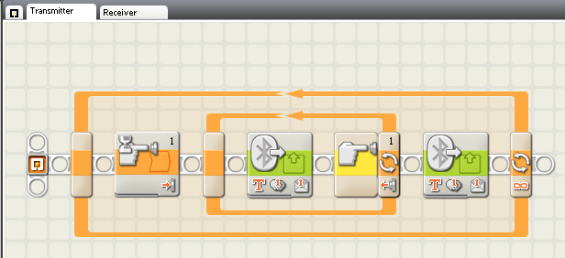
Programming the Transmitter
The pseudocode for the transmitter program is as follows:
-In a forever loop, wait until button 1 is pressed
-Send a Bluetooth message saying Forward
-Repeat this until button 1 is released
-Send a Bluetooth message saying Stop

Slide 9
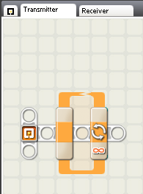
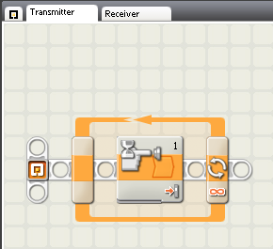
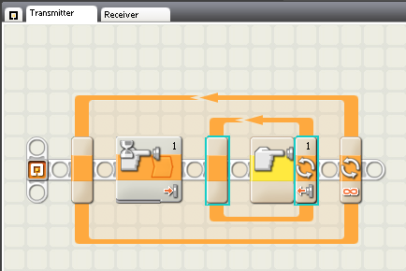
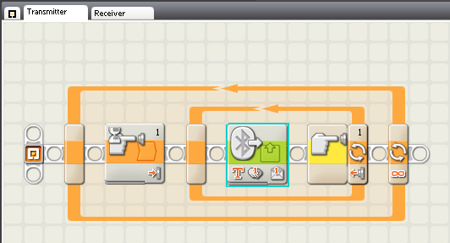
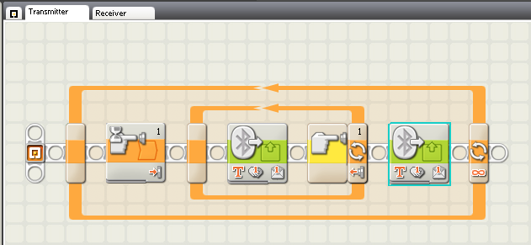
Programming the Transmitter
Start with a forever loop
Inside the loop, add a wait block for a touch sensor (pressed, port 1)
Add a touch sensor loop next to the wait block (released, port 1)
Inside the sensor loop, add a send message block (text, “Forward”, mailbox 1)
Add a send message block behind the sensor loop (text, “Stop”, mailbox 1)

Slide 10
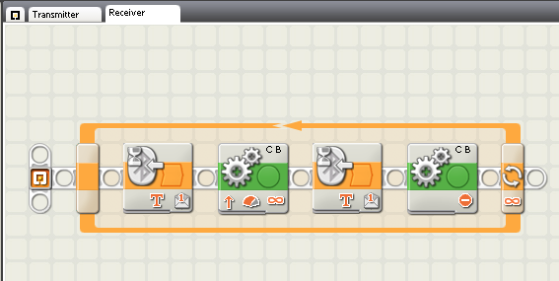
Programming the Receiver
The pseudocode for the receiver program is as follows:
-In a forever loop, wait until a message saying Forward is received
-Then move forward unlimited
-Wait until a message saying Stop is received
-Stop movement forward

Slide 11
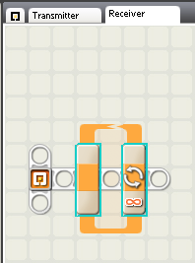
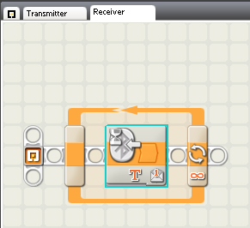
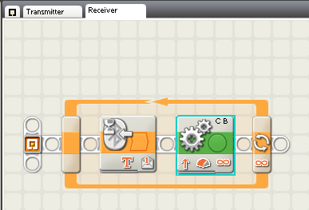
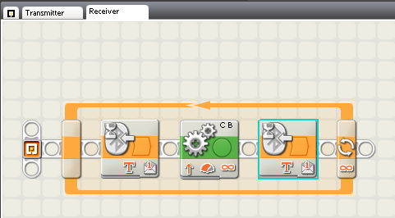
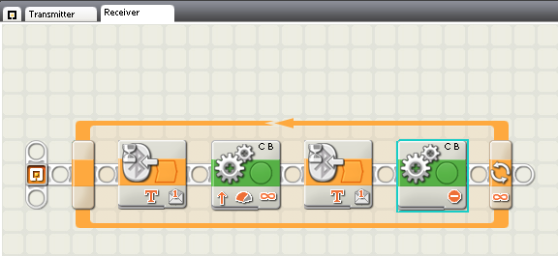
Programming the Receiver
Start with a forever loop
Inside the loop, add a wait block (receive message, compare to “Forward”)
Behind the wait block, add a movement block (forward, unlimited)
Behind the movement block, add a wait block (receive message, compare to “Stop”)
Behind the wait block, add a movement block (stop)

Slide 12
Parting Thoughts
This process can be used with any of the sensors except the rotation sensor in the motors due to the analog nature of the data collected there
You can also use all but the dark grey NXT brick buttons
It is a good idea to each robot uniquely named and to separate each sensor or button to a different mailbox to help keep things sorted out, should you need to debug any errors
The text you send can be anything, but it’s good practice to use a text that let’s you or others know the purpose of the message

